Slide 1

Krishna Engineering College

Slide 2

Employee Management System
Aanchal Gupta,Ritika Srivastava ,Sudheer Paswan,Sataywan Nishad,Vandana Sharma

Slide 3
INTRODUCTION
You’re The Employee Management System objective is to provide a system which manages the employee details, the payroll activities done in a company depending upon the employee’s attendance and its calculation is very huge. The users will consume less amount of time through computerized system rather than working manually. The system will take care of all the payroll activities like managing each employee’s attendance, number of leaves taken by that particular employee and calculation of salary in very quick manner. Data storage is easier. Paper work will be reduced and the company staffs spend more time on monitoring the progress. The system is user friendly and easy to use. All the important data’s will be stored in a database and it avoids miscalculation. Admin has the authority to add employee details. And he also has the right to edit or delete employee information to/from the list. Admin provides unique username and password for each employee through which he can login and all the information is stored in database.

Slide 4

TECHNOLOGY USED
At front end we have used ‘JAVA’ and ‘CSS’, at the backend’ and for database we have used MySQL

Slide 5
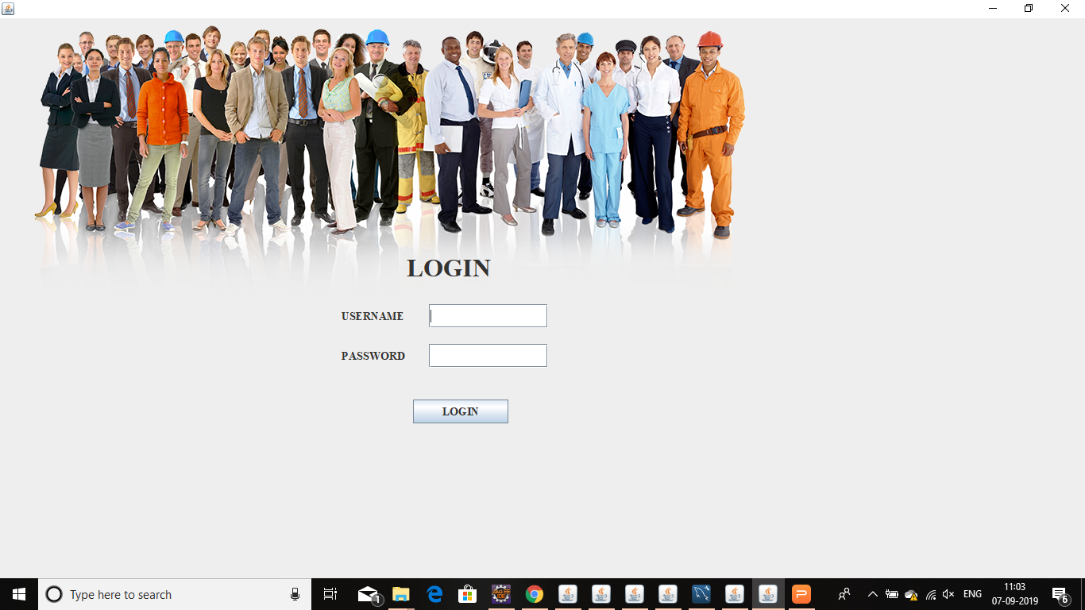
LOGIN

Slide 6

MAIN FRAME

Slide 7
MODULES
There are three Modules namely:
Admin: An administrator is a person who ensures that an organization operates efficiently. Their specific duties depend on the type of company, organization, or entity where they work. Above all, administrators need to be highly organized and have good communication skills.
HR's: Human resources (HR) is the department within a business that is responsible for all things worker-related. That includes recruiting, vetting, selecting, hiring, onboarding, training, promoting, paying, and firing employees and independent contractors.
Employee: An employee is an individual who was hired by an employer to do a specific job. ... The terms of an individual's employment are specified by an offer letter, an employment contract, or verbally. In a nonunion workplace, every employee negotiates on their own the terms of their employment.

Slide 8
5. SCOPE
This project is helpful in maintaining the employee’s record,adding details,search,delete and many more.There is also a possibility of checking salary report at any time so that it doesn’t lead to any miscalculation.

Slide 9
6.CONCLUSION
This project is used for computerizing employee management work in offices, schools, etc. The software keeps record of employee’s attendance, provident fund, gratuity and generate. The software is capable of easy storage of information related to employee through database.

Slide 10
At last
Thank you

